Slide 1

Work Experience
GET IT ON UNIFROG AS SOON AS YOU HAVE IT CONFIRMED
You are RAPIDLY running out of time!
It is NEXT WEEK
1 week to go!
13th – 17th July 2026

Slide 2
Before you go next week you need to:
Check timings
Check dress code
Check lunch arrangements
You can do all of this in the Employer Form on Unifrog

Slide 3
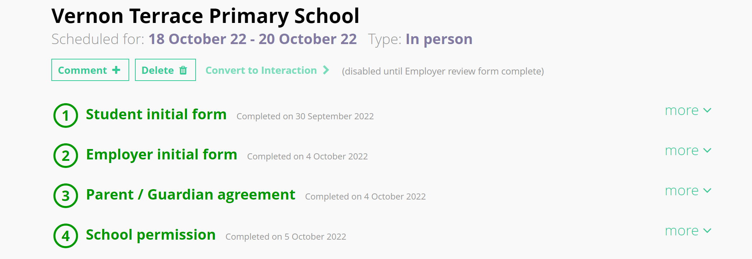
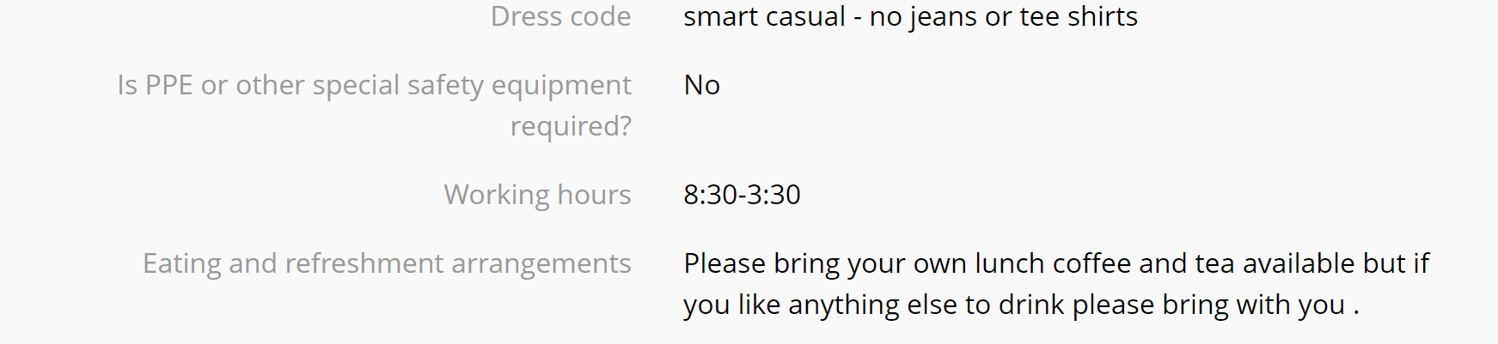
Next look through each of the sections in the form to find the information
First, go to the Employer Form (via the Placements Tool)

Slide 4
Now you need to consider getting there:
Transport – do you know the route if you’re driving?
If you’re driving independently, what are the parking arrangements?
How long does it take?
Which bus/train you are getting?
How long does it take to walk from the station to the office?

Slide 5

Mobile Phone & Social Media

Slide 6
Phone on silent at all times
Phone should be kept in your bag, not on your desk or visible in your working environment
No using your phone unless on your break or lunch break
Don’t post anything on social media about the company, and definitely do not post any pictures/videos when you are physically in the business

Slide 7
Concerns
If you have concerns on placement or don’t feel safe, email us straightaway
Email:
Mrs Rickaby-Collins
Mrs Tilley
Mrs Adeyemi
Mr Bradbury
the work experience inbox
workexperience@nsb.northants.sch.uk

Slide 8
Illness/Medical issues
If you are ill whilst on placement you must let school AND the placement provider know straightaway.
This can be via phone or email.
It is NOT the school’s responsibility to let the placement provider know if you are ill.
If you don’t have a placement and are due in school next week, you phone the absence line as normal.

Slide 9
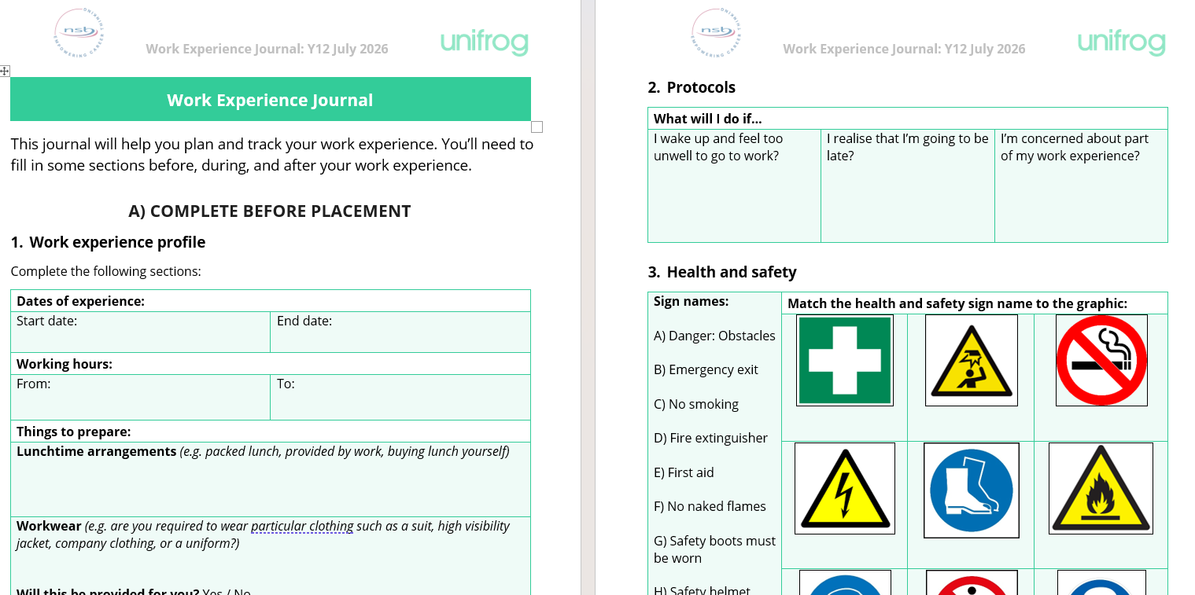
Work Experience Journal
COMPULSORY
Your work experience journal is a compulsory part of your work experience programme.
There are 3 main sections:
Pre-placement
During placement
Post-placement
The journal is in your Unifrog locker and should be downloaded and saved to your personal device. We are also printing a copy for each of you which your FT will give you on Friday so that you can complete the during placement tasks whilst in the organisation each day.

Slide 10
Work Experience Journal
COMPULSORY
We have also contacted your host organisation with a copy of the booklet so they know what you are being asked to do whilst you are there (on top of all the tasks they will give you)

Slide 11
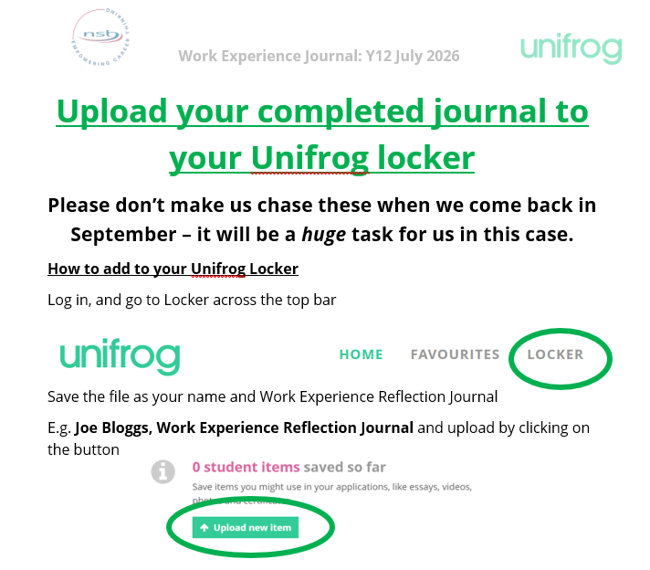
Work Experience Journal
COMPULSORY
At the end of the week, you need to upload a completed digital version back to your Unifrog locker.
There are instructions in the journal to help you.
Treat it like a homework task, if we come back in September and they are missing, we will start issuing detentions. We will give you until the end of Week 1 in September to get it uploaded.

Slide 12
Check Ins
We have a duty to check in on you whilst on placement.
We will contact your employers on Monday, Wednesday and Friday of your placement to see how things are going.
These check ins are nothing to worry about – it is simply for us to ensure you are there and safe, the employer is happy with you on site and that everything is going smoothly

Slide 13
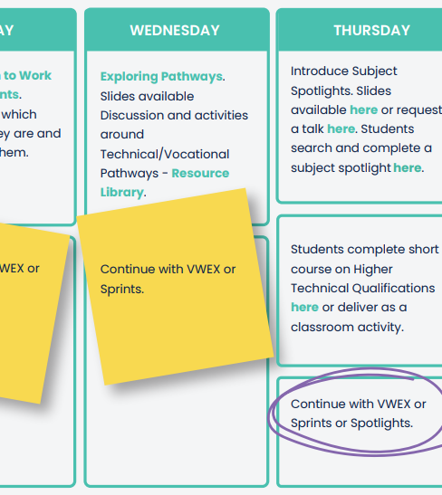
Virtual/no work experience
If you don’t have an in-person placement secured for July, you are expected in school on Monday morning as normal.
Please go to the 6th form center where one of the Study Centre Team will register you.
You will undertake virtual work experience for the week.
If you don’t come to school (without a valid reason) then you will be considered as ‘truanting’ which means a meeting with Mr Bernard when you come back
FINAL DEADLINE TO SECURE A PLACEMENT: FRIDAY 10th JULY MIDDAY

