Slide 1
NSB Parent & Carer Guide
What to expect in the event of a partial closure when students are required to self-isolate due to a confirmed case of COVID-19 in the school community
1
2
3
4
5
General Expectations
Live lessons
Feedback
Some useful tools
FAQs
Expectations about the timetable and how students will receive work during a partial closure.
Guidance about live lessons and when/how these may take place. Reminders about how to use MS Teams.
How will students receive feedback and what can they expect during a partial closure?
What are the main educational tools that we are using across the school and how do they support our students?
Some other common questions and guidance to support parents and carers.
Notes:
MRO

Slide 2
How much work will my child receive?
Year group | How much work to expect?
Year 7-10 | Equivalent of a normal timetable of 7 x 45min lessons per day. Students will not be expected to complete additional home learning tasks but will have further optional tasks set for those students who wish to complete more.
Year 11-13 | Equivalent of a normal timetable of 7 x 45min lessons per day. Students will also be expected to complete additional home learning tasks
Notes:
MRO

Slide 3
How will my child know what to complete?
All teachers will set work through the AIM platform. Students can access this throughout the day and use AIM to return work to teachers to check and provide feedback where necessary.
Students will be provided with deadlines for completion.
Students can ‘tick off’ tasks as they complete them to help with their organisation.
If students have a ‘live’ lesson on Microsoft Teams, staff will notify them by posting this on AIM so they can join and participate.
Whilst all students will receive work through the AIM platform, they may be directed to use other subject-specific resources and online content.
Teachers will aim to ensure consistency so students are not having to use multiple different platforms throughout the week.
Students will already be familiar with these platforms from lockdown so hopefully feel more confident in accessing the work.
All relevant links will be set through AIM.
Notes:
MRO

Slide 4
The 6 Principles
Challenge
All students will be encouraged to ‘think hard’ and strive towards high academic aspirations.
Explanation
Clear explanations are essential for students to acquire and understand new knowledge.
Modelling
Students are shown how to acquire new knowledge through concreate examples, exemplars and live modelling.
Questioning
Students demonstrate their understanding and are given time to think with greater breadth, depth and accuracy.
Retrieval and Deliberate Practice
Students apply their knowledge and understanding to more complex tasks to prove they can apply their learning.
Feedback
Students can address any gaps and misconceptions in their knowledge and skills with follow-up tasks to support.
At NSB, we are clear about what makes effective teaching and learning in the classroom and our curriculum is shaped by 6 core principles.
These principles are also at the heart of our online curriculum too and students will continue to experience the same aspirational expectations and routines that they have in the classroom.

Slide 5
The Curriculum
Students will still have access to the same broad and rich curriculum we offer at NSB. Students will given the opportunity to engage with all aspects of the curriculum and will be taught across their normal timetabled lessons, including their weekly PSHE lesson with form tutors.

Slide 6
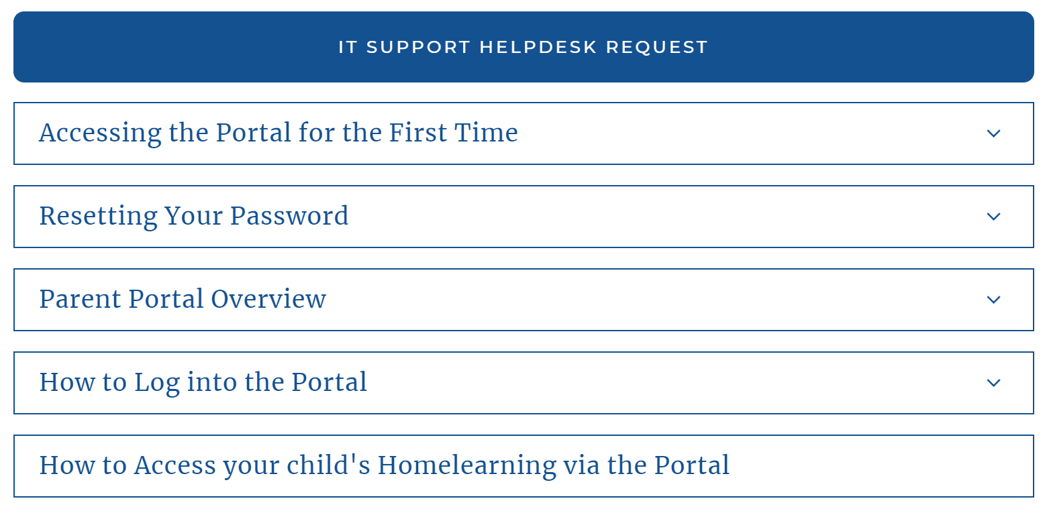
Can I check what my child has to complete?
All parents/carers can log in to the parent portal of AIM and view the work set for your child each week. You can check deadlines, review progress and support your child with their time management to ensure all tasks are completed.
If you have not received your invitation email to access the parent portal or experience any technical issues, please feel free to contact the IT team by completing the online help desk request on the website.
Notes:
MRO

Slide 7
Methods you could use to reinforce expectations…
Reward your child when they complete particularly challenging or impressive work.
Offer regular praise for simply sticking to a routine.
Create a point-based reward system where students can ‘cash-in’ their points for other privileges.
Email form tutors with your feedback so they can also congratulate students and award house points!
Remind them to take short rest-breaks every 45 minutes to help maintain focus.
Following the normal timetable will help with routines and ensure that students build in break and lunch times.
Reinforce sanctions when students fail to complete work i.e. confiscate phones/consoles and restrict screen time where necessary.
Email form tutors with any major concerns so they can liaise with Year Team Leaders where necessary.
Notes:
MRO

Slide 8
NSB Parent & Carer Guide
What to expect in the event of a partial closure when students are required to self-isolate due to a confirmed case of COVID-19 in the school community
1
2
3
4
5
General Expectations
Live lessons
Feedback
Some useful tools
FAQs
Expectations about the timetable and how students will receive work during a partial closure.
Guidance about live lessons and when/how these may take place. Reminders about how to use MS Teams.
How will students receive feedback and what can they expect during a partial closure?
What are the main educational tools that we are using across the school and how do they support our students?
Some other common questions and guidance to support parents and carers.
Notes:
MRO

Slide 9
Will lessons be delivered live?
Some lessons and materials will be delivered live through Microsoft Teams. This will only be possible in the event of a full/partial year closure when large numbers of students are forced to isolate.
In the event of a full/partial year closure, live content may be delivered in 2 ways:
Teachers may introduce the lesson materials at the start via MS Teams or a pre-recorded PPT with voice-over instructions. Students then complete work independently but can ask the teacher for support during the timetabled lesson via the MS Teams chat function. Any pre-recorded content will be shared on AIM.
Teachers may deliver the whole lesson ‘live’ using MS Teams. Students will be able to follow the lesson and submit responses via the live chat. Live lessons may be used to introduce new content before allowing students to complete more independent work. Students will generally have their cameras and microphones deactivated but may be invited to use them at specific points in the lesson.
Students can ask teachers for further guidance and support during the timetabled lesson via the Microsoft Teams chat function.
This will only be possible during a partial or full year closure.
Notes:
MRO

Slide 10
Students must follow their normal timetable to ensure that they can participate in any live content and ask teachers any necessary questions during the 45 minute lesson.

Slide 12
Things to remember:
All students will be enrolled in all their classes on Microsoft Teams.
Students will need to feel confident when accessing Teams on their home computer if they haven’t used this already during lockdown.
Look at the student guide below if they are struggling with how to use the software.

Slide 13
How does my child access Teams?
All students have been reminded how to access Teams during assemblies. They can access it through their NSB email or by downloading the software and logging in to view their classes.
If students struggle to find Teams, they can follow this guidance.

Slide 14
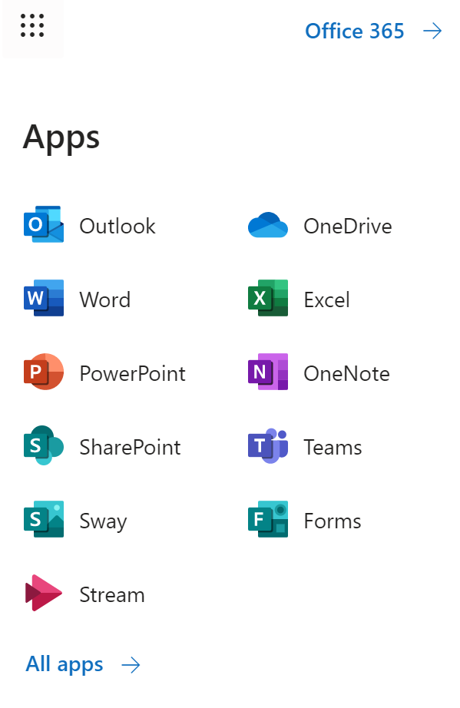
How does my child access Teams?

Slide 15
If students are completing work independently (set through AIM) but need more help and guidance, they can use the ‘Chat’ function to contact their teacher and ask for support. They can only do this during their 45 minute timetabled lesson.
Students can find their classes here. All classes will match their timetables so they can easily switch between subjects. Students can select a class to see any materials that may have been added there.
Students can check their calendar to see if they have a timetabled ‘live lesson’ during the week. They will already have been notified about this through AIM but they can ‘Join’ the lesson through here and participate in the lesson.

Slide 16
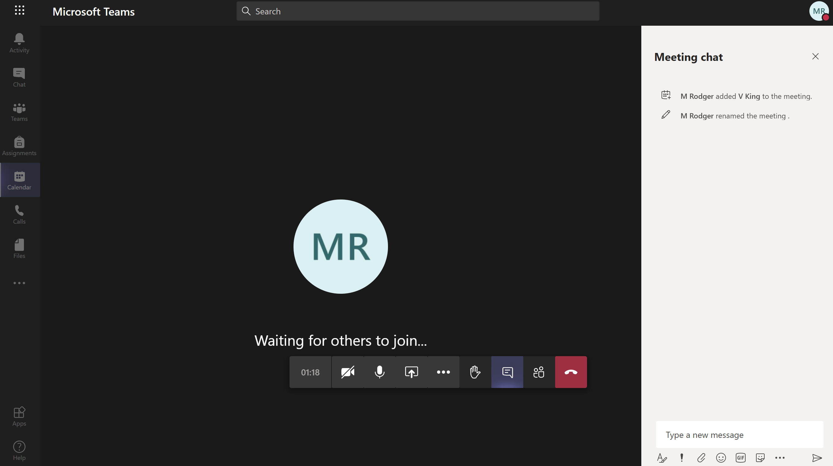
Students can respond to the lesson, ask questions and provide feedback in this ‘chat’ box.
Teachers can then help to clarify explanations and provide further instruction.

Slide 17
NSB Parent & Carer Guide
What to expect in the event of a partial closure when students are required to self-isolate due to a confirmed case of COVID-19 in the school community
1
2
3
4
5
General Expectations
Live lessons
Feedback
Some useful tools
FAQs
Expectations about the timetable and how students will receive work during a partial closure.
Guidance about live lessons and when/how these may take place. Reminders about how to use MS Teams.
How will students receive feedback and what can they expect during a partial closure?
What are the main educational tools that we are using across the school and how do they support our students?
Some other common questions and guidance to support parents and carers.
Notes:
MRO

Slide 18
How can my child submit their work?
All students should be confident with using AIM from their usual home-leaning tasks. Students can copy and paste work into AIM, upload an attachment or scan a document.
If students complete work by hand, they can also use the Office Lens app to take pictures of multiple pages and convert them to one file read to upload to AIM.
Notes:
MRO

Slide 19
Teachers will be providing direct feedback to students on some set tasks to check their progress.
They may also be asked to complete knowledge-based tests online to check their understanding at regular intervals.
Getting students to share what they’re learning can be great for motivation too!

Slide 20
How will my child receive feedback?
Teachers will monitor work as students submit completed tasks via AIM or Teams.
Feedback may be given in a variety of ways, depending on the nature of the task:
Students may receive immediate feedback via the ‘live chat’ function in Teams during a lesson.
Students may ask their teacher for 1-1 help and support during their normal timetabled lesson when completing independent work set through AIM.
Students may receive whole class feedback after responding to a task. Teachers will identify areas of strength and development, clarify misconceptions and set follow-up tasks where necessary.
Students may be asked to complete a quiz/test through Microsoft Forms or similar which will provide immediate feedback and marks.
Students may be asked to submit a piece of extended work through AIM or Teams. Teachers will then provide appropriate feedback depending on the nature of the task.
Notes:
MRO

Slide 21
How will I know if my child is not completing work?
All students know what is expected of them during any period of school closure. Teachers will be monitoring the work to ensure that students are engaging with the lesson materials and submitting any necessary work.
If students persistently fail to submit work or join any live lessons, teachers will be in touch via email or phone to inform you and potentially speak to the student.
Remember you can monitor your child’s home learning through the parent portal on AIM (see FAQs for more details)
How can I create a space at home where my child can work?
Students do not require a dedicated study space where they complete their work, but you can help in other ways:
Try to ensure they are working away from other devices and distractions such as phones and TV.
Encourage students to choose a regular spot with a table/desk that supports them with a routine
Encourage students to complete some work by hand so they are having breaks from screen-time
Notes:
MRO

Slide 22
NSB Parent & Carer Guide
What to expect in the event of a partial closure when students are required to self-isolate due to a confirmed case of COVID-19 in the school community
1
2
3
4
5
General Expectations
Live lessons
Feedback
Some useful tools
FAQs
Expectations about the timetable and how students will receive work during a partial closure.
Guidance about live lessons and when/how these may take place. Reminders about how to use MS Teams.
How will students receive feedback and what can they expect during a partial closure?
What are the main educational tools that we are using across the school and how do they support our students?
Some other common questions and guidance to support parents and carers.
Notes:
MRO

Slide 23
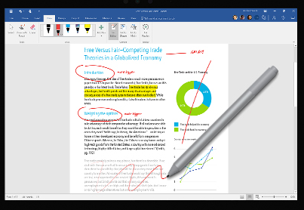
What are some of the tools you use to help deliver online learning?
Notes:
MRO

Slide 24
NSB Parent & Carer Guide
What to expect in the event of a partial closure when students are required to self-isolate due to a confirmed case of COVID-19 in the school community
1
2
3
4
5
General Expectations
Live lessons
Feedback
Some useful tools
FAQs
Expectations about the timetable and how students will receive work during a partial closure.
Guidance about live lessons and when/how these may take place. Reminders about how to use MS Teams.
How will students receive feedback and what can they expect during a partial closure?
What are the main educational tools that we are using across the school and how do they support our students?
Some other common questions and guidance to support parents and carers.
Notes:
MRO

Slide 25
What if my child can’t access a computer/device throughout the day?
If your child has any issues with access to the necessary equipment, please contact Matt Kneeshaw (Deputy Headteacher) at mkn@nsb.northants.sch.uk who can advise you further.
Some tasks will be possible to complete on paper if students wish to do so. They can then upload images of their work using then guidance on slide 18.
Notes:
MRO

Slide 26
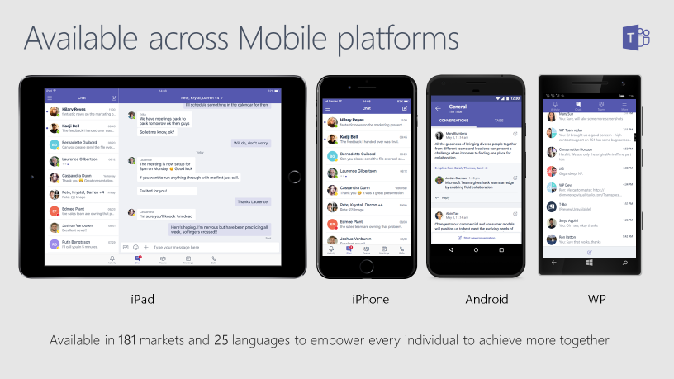
What if my child can’t access a computer/device throughout the day?
Notes:
MRO

Slide 27
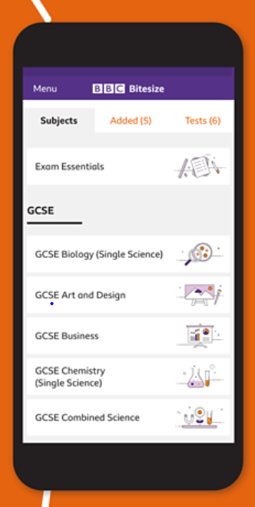
What else can my child use if they complete all the set work?
BBC Sounds app is also launching separate podcasts to support everyone learning at home. The daily shows, each around 10 minutes long, will link with content on Bitesize to support students’ educational needs and their emotional well-being.
Bitesize also has an app. This will be providing daily lessons for 14 and 15 year olds. Find out more about the app here:
https://www.bbc.co.uk/bitesize/articles/zgd682p
Oak National Academy have released all of their lessons and online curriculum for students to use. Students can search by subject and topic to further support their studies. The online classroom can be accessed here:
https://classroom.thenational.academy/

Slide 28
Additional resources and links
Newsround:
https://www.bbc.co.uk/newsround
Seneca: Pick from 1000+ KS2, KS3, GCSE & A Level courses based on exam board specifications.
https://www.senecalearning.com/
Quizlet: Interactive flash cards and knowledge tests to check understanding.
https://quizlet.com/en-gb
Duolingo: Continue to develop language skills in MFL
https://www.duolingo.com/

